Slide 1
Module 5(Part 2): Hashing
Hashing- Hashing Techniques, Collision Resolution, Overflow handling, Hashing functions – Mid square, Division, Folding, Digit Analysis

Slide 2
Hash Table
Hash Table is a data structure which help us to retrieve information very effectively.
It is an array of constant size and contains key values.
Key values are placed into hash table. The array index where key values are present is calculated from the key itself.
Hash Table uses hash technique/function to generate index where a key value is stored. This process is known as hashing.

Slide 3
Hashing
Hashing is a technique of mapping keys into indices in a hash table by using a hash function.
H: K→I where H is the mapping hash function
K is the set of key value
I is the range of indices
The main idea behind any hashing technique is to find a one to one correspondence between a key value and index in the hash table where the key value can be placed.

Slide 4
Hashing
Few criteria while deciding hash function:
The function H should be very easy and quick to compute
The function H should as far as possible give two different indices for two different key values. i.e. there should be minimum no. of collision
Eg: H: k mod m where m is usually prime no.
K={17,10,19,35,43,62} m=7
0 | 35
1 | 43
2
3 | 10,17
4
5 | 19
6 | 62
Hash Table

Slide 5
Eg: Consider a hash table of size 10 whose indices are 0,1,2…9. Suppose a set of key values are: 10,19,35,43,62,59,31,49,77,33.
Assume the hash function, H as stated below:
1. Add the two digits in the key.
2. Take the digit in units place of the result as index.

Slide 6
K | I
10 | 1
19 | 0
35 | 8
43 | 7
62 | 8
59 | 4
31 | 4
49 | 3
77 | 4
33 | 6
0 | 19
1 | 10
2
3 | 49
4 | 59,31,77
5
6 | 33
7 | 43
8 | 35,62
9
H:K->I
Hash Table

Slide 7
Collision
Key values were not distributed uniformly in the previous example.
There were many Blank entries
Some entries had more than one key values.
Allotment of more than one key value to a location is known as collision.
Good hash function has minimum number of collisions and distributes keys uniformly.

Slide 8
Hash Functions
Some popular hash functions are:
Division method
Mid square method
Folding method
Digit Analysis method

Slide 9
Hash Functions
Division method
It is one of the fastest hashing function and most widely accepted one.
Choose a number h, larger than N(no of keys)
Then Hash function H
H(k)=k(MOD h) if index start from 0
H(k)=k(MOD h)+1 if index start from 1
where k is an element of set of key values
Usually h may be any prime number since this usually minimises the number of collisions.

Slide 10
Example: Assume that the hash table size is 8. Consider the key values 10,21,4,41,24,14,17,15,31. Apply division method and find the index of each key value.
Ans: Here the hash function is H(k) = k % 8
Key | Hash Function | Index
10 | 10%8 | 2
21 | 21%8 | 5
4 | 4%8 | 4
41 | 41%8 | 1
24 | 24%8 | 0
14 | 14%8 | 6
17 | 17%8 | 1
15 | 15%8 | 7
31 | 31%8 | 7
Hash Table
Index | Key
0 | 24
1 | 41,17
2 | 10
3
4 | 4
5 | 21
6 | 14
7 | 15,31
Collision
Collision

Slide 11
Hash Functions
Mid square method
The hash function H is
H(k) = x
Where x is obtained by selecting some digits from the middle of the square of the key value k.
Selection usually depends on the size of the hash table. If size=100, then choose two bits.
Keys are uniformly distributed so there is less collision. But it is not an efficient method as it is time consuming.
k | k² | H(k)
1234 | 1522756 | 525
2345 | 5499025 | 492

Slide 12
Hash Functions
Folding method
Here the key k is partitioned in to number of parts, k₁,k₂…k_{n}
Each part except possibly the last, has the same no of digits as the required address.
These parts are added together ignoring the last carry.
The hash function H(k) = k₁+k₂+. . K_{n}
k | H(k) | Index
3407 | 34+07 = 41 | 41
9020 | 90+20=110 | 10
15889 | 15+88+9=112 | 12

Slide 13
Hash Functions
Folding method
Three variation of folding
Pure folding
Fold shifting – even parts are reversed before addition.
Fold boundary – boundary parts are reversed before addition.
Eg: K: 1522756
Chopping : 01 52 27 56
Pure folding : 01+52+27+56 = 136
Fold Shifting: 10+52+72+56 =190
Fold Boundary: 10+52+27+65 =154

Slide 14
Hash Functions
Digit Analysis method
Here, the hash address is formed by extracting the digits and rearranging them.
Example: key-6732541 can be transformed to hash function 427 by extracting digits in even positions and then reversing the combination.
The decision for extraction and rearrangement is based on some analysis.
Here, an analysis is performed to determine which key position should be used in forming hash address.
For each criterion, hash addresses are calculated and then a graph is plotted, then that criterion is selected which produces the most uniform distribution

Slide 15
Collision Resolution Techniques
Two collision resolution techniques are:
Closed hashing / Open Addressing /Linear Probing
Open hashing / Closed Addressing / Chaining

Slide 16
Closed Hashing(Open Addressing)
The simplest method to resolve a collision.
Here all elements are stored in the hash table itself. That’s why it is called Open addressing.
The hash table is considered circular. That’s why the technique is termed closed hashing.
Since the techn

Slide 17
Closed Hashing(Open Addressing) contd.
Suppose Hash Table of size S and K is the key to be mapped to location i.
But there is collision at i^{th} location(another key value is found in same location i)
Then do a sequential search in the following locations
i+1,i+2……S,1,2,3…..i-1
This search will continue until
The key value is found. (successful search)
An unoccupied location found.
Search reaches the location where it had started.
Since technique searches in straight line, it is called linear probing

Slide 18
Eg: 15 11 25 16 9 8 12 8
H=10
H(k)=k MOD 7+1

Slide 19
1 |  |  | 1 |  |  | 1 |  |  | 1
2 | 15 |  | 2 | 15 |  | 2 | 15 |  | 2 | 15
3 |  |  | 3 |  |  | 3 |  |  | 3 | 16
4 |  |  | 4 |  |  | 4 |  |  | 4
5 |  |  | 5 | 11 |  | 5 | 11 |  | 5 | 11
6 |  |  | 6 |  |  | 6 | 25 |  | 6 | 25
7 |  |  | 7 |  |  | 7 |  |  | 7
8 |  |  | 8 |  |  | 8 |  |  | 8
9 |  |  | 9 |  |  | 9 |  |  | 9
10 |  |  | 10 |  |  | 10 |  |  | 10
1 |  |  | 1 |  |  | 1 |  |  | 1
2 | 15 |  | 2 | 15 |  | 2 | 15 |  | 2 | 15
3 | 16 |  | 3 | 16 |  | 3 | 16 |  | 3 | 16
4 | 9 |  | 4 | 9 |  | 4 | 9 |  | 4 | 9
5 | 11 |  | 5 | 11 |  | 5 | 11 |  | 5 | 11
6 | 25 |  | 6 | 25 |  | 6 | 25 |  | 6 | 25
7 |  |  | 7 | 8 |  | 7 | 8 |  | 7 | 8
8 |  |  | 8 |  |  | 8 | 12 |  | 8 | 12
9 |  |  | 9 |  |  | 9 |  |  | 9
10 |  |  | 10 |  |  | 10 |  |  | 10

Slide 20
Drawbacks
When half the table is full it is difficult to find empty space in case of collision.
As hash table gets filled, there is tendency towards clustering.
Clustering results in delayed search.
The type of clustering where key values are clustered in large groups is known as primary clustering
Following are some solutions to avoid this situation.
Random Probing
Double Hashing or rehashing
Quadratic probing

Slide 21
Random Probing
Uses a random number generator to generate random locations.
Random number generated contains all positions from 1 to h where h is the size of the hash table.
Eg i=(i+m)mod h+1
where i is number in the sequence
m and h are integers that are relatively prime to each other

Slide 22
Eg : i starts at 2, m=5 and h=11
i=(i+m)mod h+1
Locations generated are
(2+5)mod 11+1=8
(8+5) mod 11+1=3
(3+5)mod 11+1=9
=?
=?
Stop producing the random number when the first position is duplicated.
Avoids primary clustering.

Slide 23
Quadratic Probing
Eliminates primary clustering problem of linear probing.
In linear probing, if there is a collision at i, then next locations are i+1,i+2,i+3…
But in Quadratic probing, if there is a collision at i, then probe on i+1²,i+2²,i+3² etc..
H(k)+i² MOD h for i=1,2,3…….

Slide 24
Double Hashing
Uses a second hash function in addition to the first one.
Second hash fn should be selected in such a way that the hash address generated by two function should be distinct.
Let key x be stored in index f(x)=t of the hash table.
In case of collision, define a second hash function f₂(x)=d. Attempt to store key in array elements (t+d)%N, (t+2d)%N,(t+3d)%N… until an empty slot is found. Here N is the size of hash table.
Typical second hash function is
f₂(x)=R-(x%R) where R is a prime number, R<N.

Slide 25
Q1: Array elements to be inserted to hash table are 47,35,36,129,25,2501,65,29,16,14,99,127
H₁(x)=x%15
H₂(x)=11-(x%11)
Create a hash table of size=15 using double hashing.

Slide 26
Open Hashing
Drawbacks of closed hashing
Closed hashing is unable to handle overflow.
Most of the keys vary from their original locations so much that it degrades the performance.
So another method to resolve collision is open hashing/Separate Chaining/Simple chaining.

Slide 27
Chaining method uses hash table as an array of pointers, each pointer points to a linked list.
For a given key value, hash address is calculated.
Hash address is decided by the last bit of the key.
It then searches the linked list pointed by the hash address at that location.
If found return the pointer else insert the key as last node in the list.

Slide 28
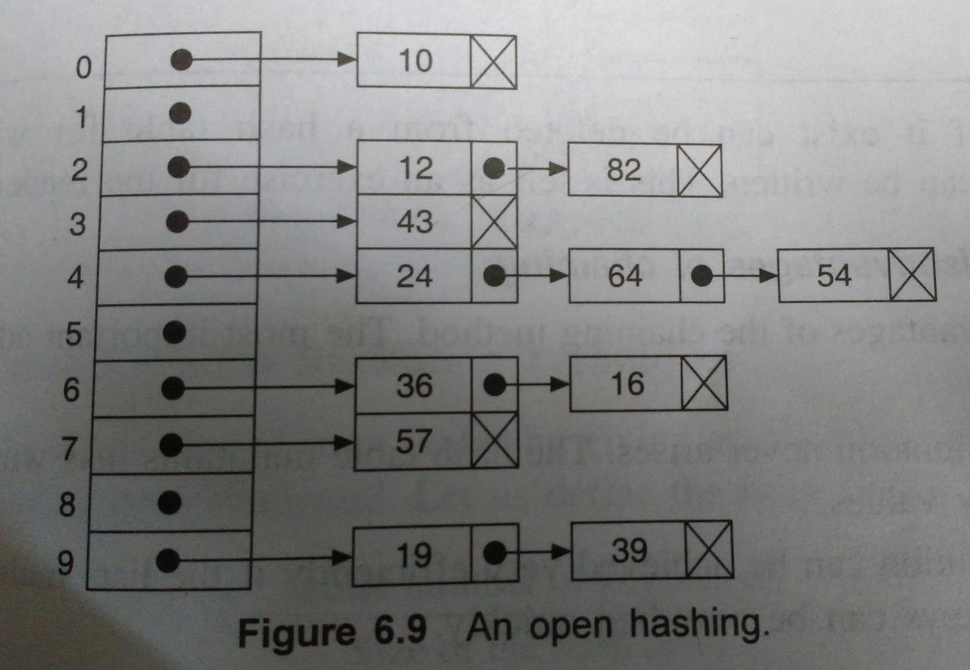
Eg: K={10,43,12,16,82,36,19,57,54,24,64} Index of hash table varies from 0 to 9 and key values are taken as integers. Hash function returns integer at the last position of key.

Slide 29
Advantages
Overflow situation never arrives
If the list is sorted , searching is easy
Insertion and deletion is fast
Suitable for application where number of key values varies drastically as open hashing uses dynamic storage management.
Disadvantage
Extra storage required to maintain a Linked Lists.
Applications:
Retrieval of data
Verification of message integrity.
Password Verification

